Slide 1
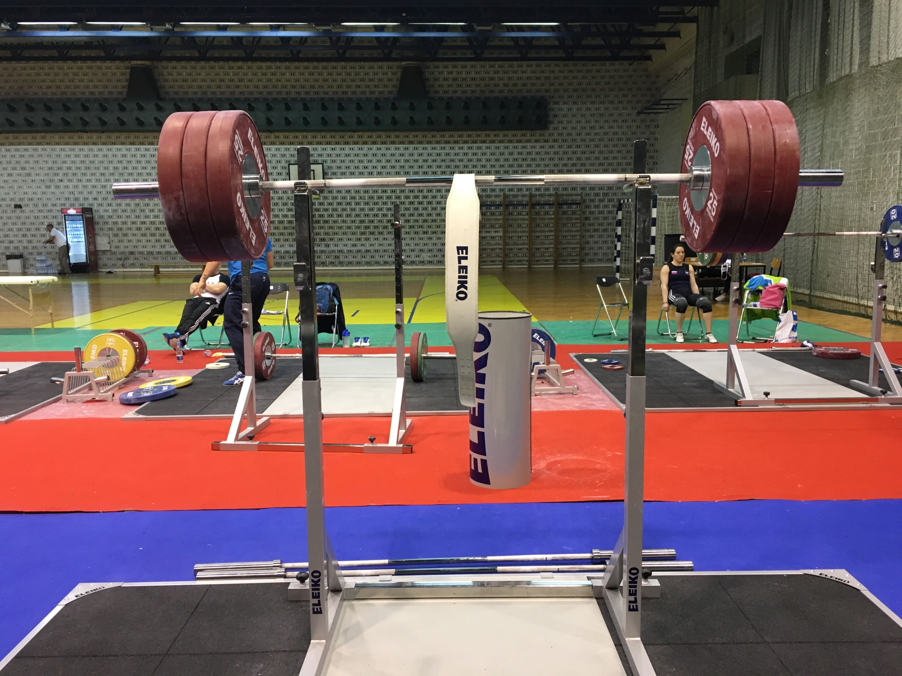
Powerlifting and Comparing Strengths
By: Davis Ly

Slide 2
Outline
What is powerlifting?
Data
Powerlifting in the world at a glance
Gender differences
Comparing athletes at different weights
Allometric scaling

Slide 3
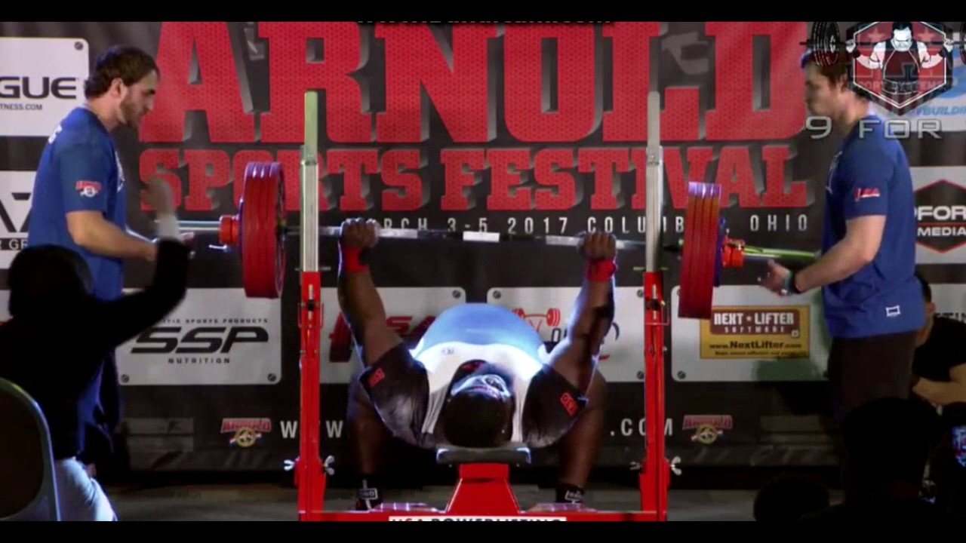
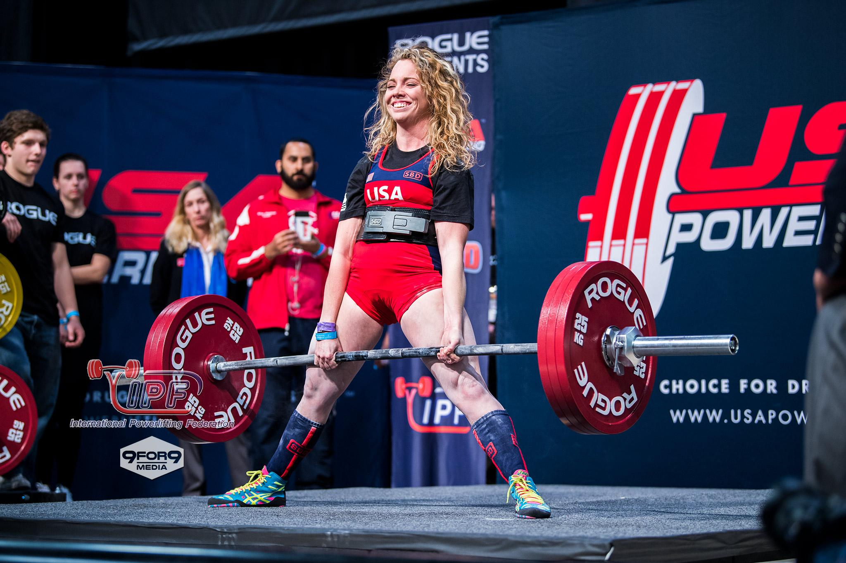
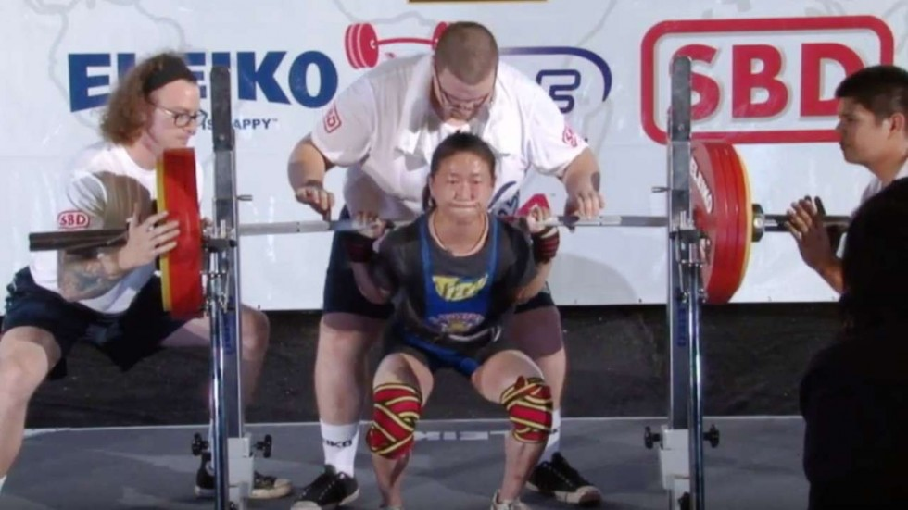
What is powerlifting?
Bench Press: Ray Williams
Bench Press: Ray Williams
Squat: Wei-Ling Chen
Deadlift: Heather Connor

Slide 4

Data
Specific filtering:
Competitor completed 1 of each lift in meet
Competitor competed in at least 2 meets
Only drug-tested federations
Source:
https://www.openpowerlifting.org/data
Snapshot of the database:

Slide 5
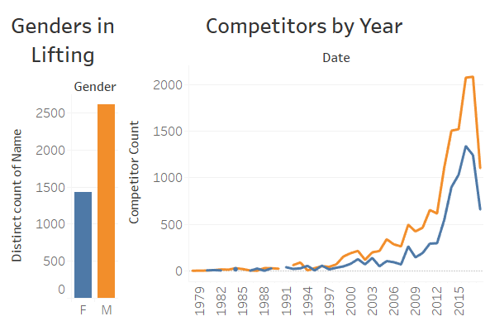
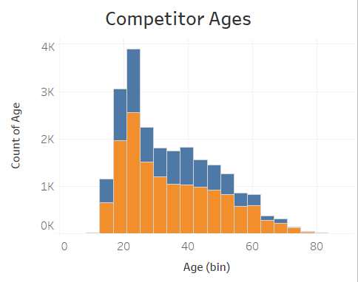
Powerlifting in the world at a glance - Part 1

Slide 6
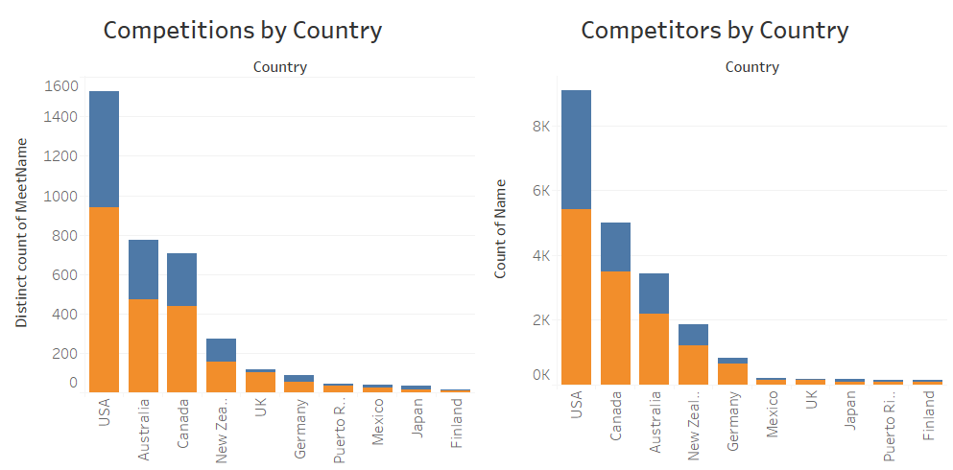
Powerlifting in the world at a glance - Part 2

Slide 7
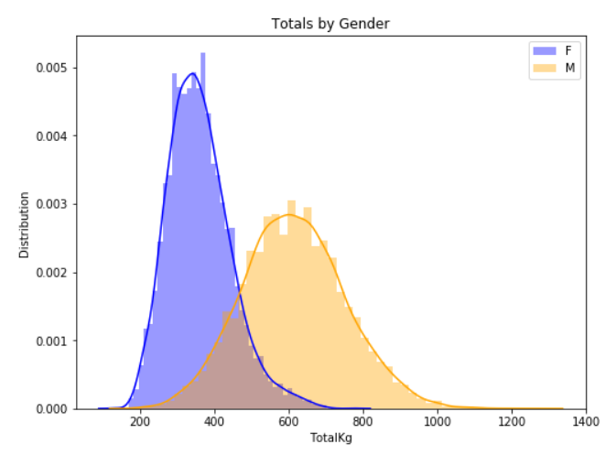
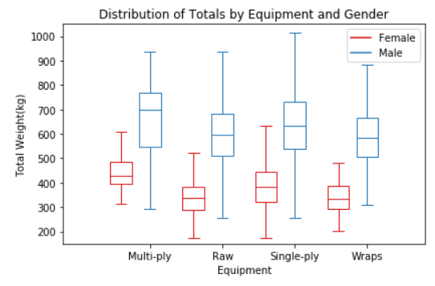
Gender and equipment differences - Part 1

Slide 8
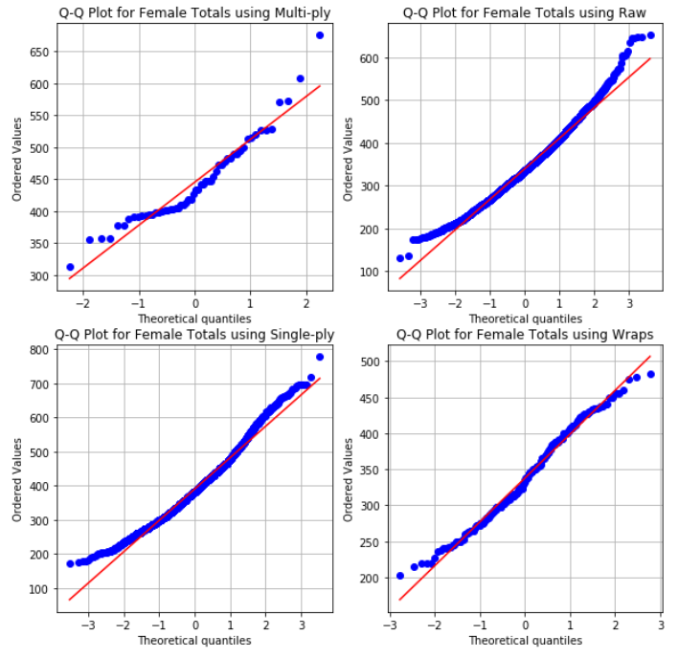
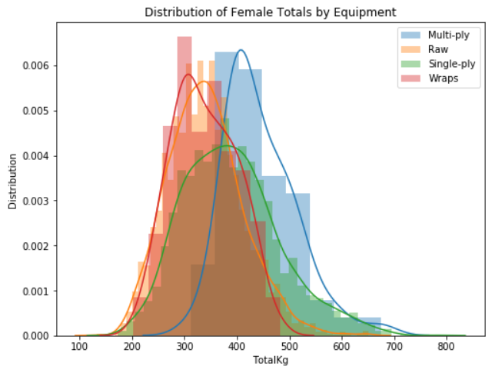
Gender and equipment differences - Part 2

Slide 9
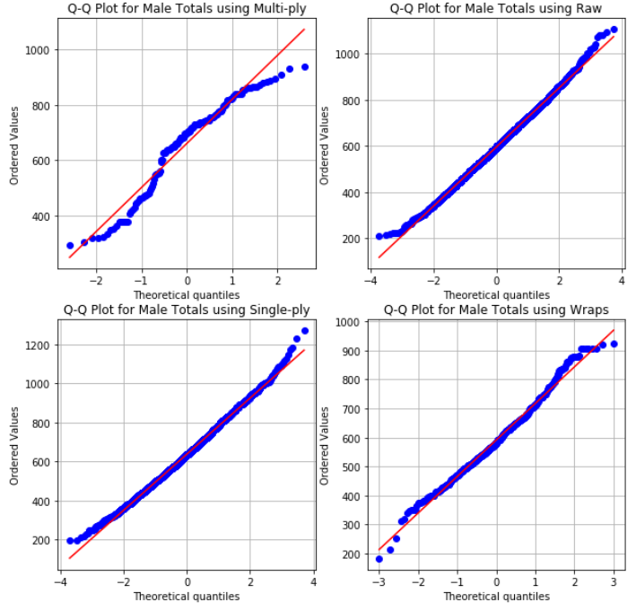
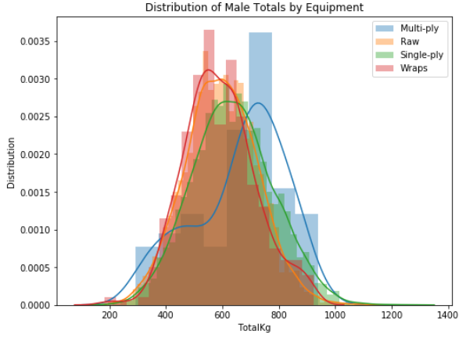
Gender and equipment differences - Part 3

Slide 10
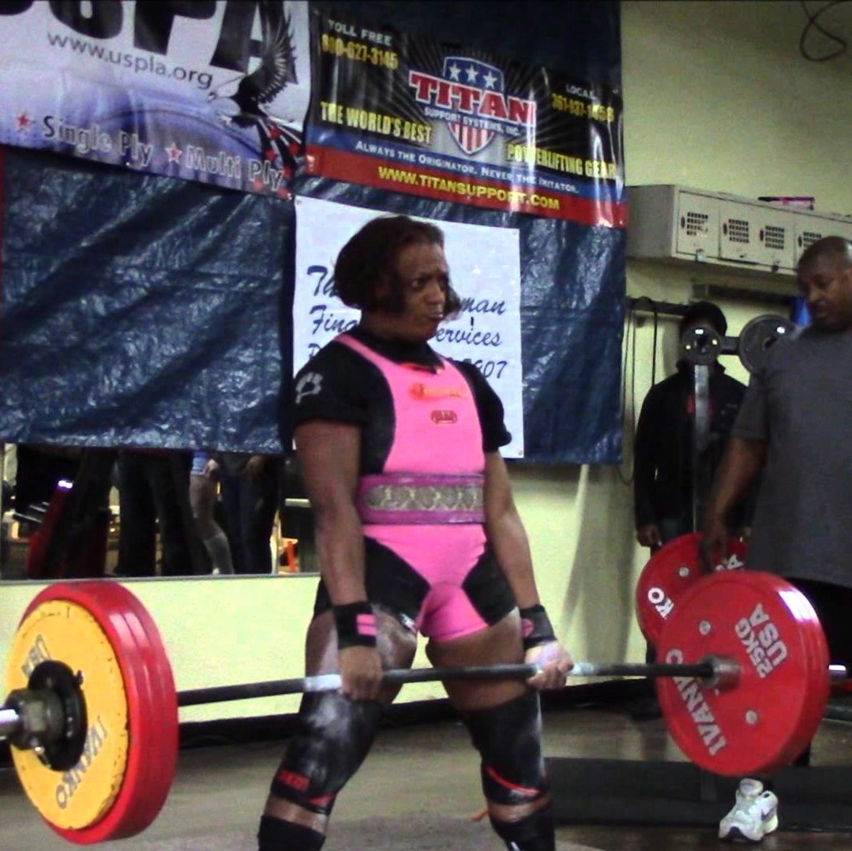
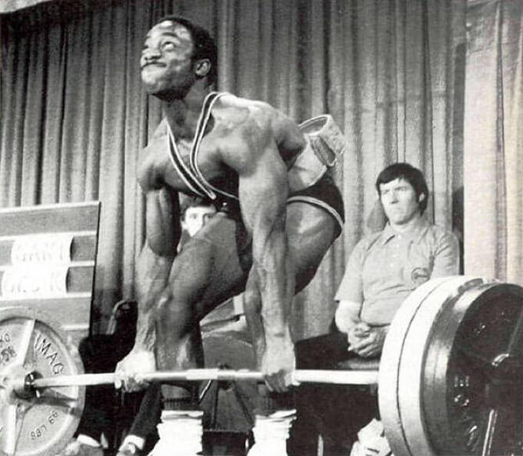
Comparing athletes at different weights - Part 1
Sebrina Davis 227 kg deadlift @ Age 45, BW: 85.9 kg
Lamar Gant 5xBW deadlift at 56 kg

Slide 11
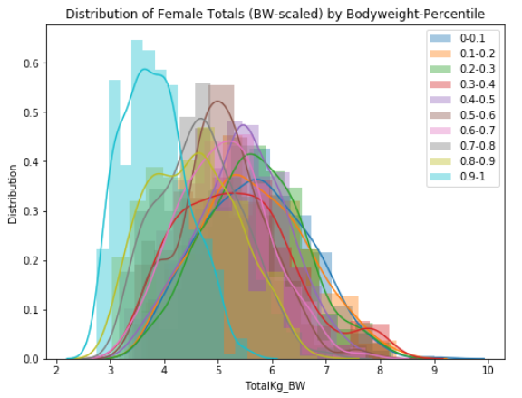
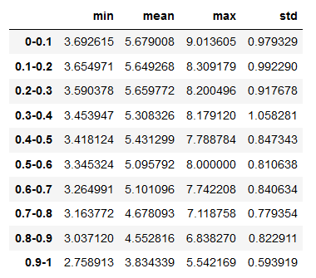
Comparing athletes at different weights - Part 2

Slide 12
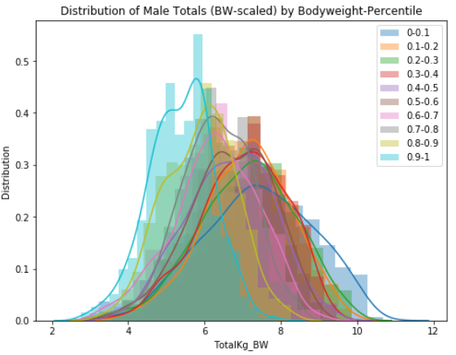
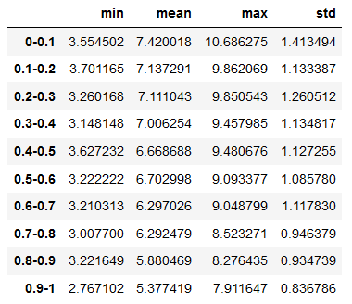
Comparing athletes at different weights - Part 3

Slide 13
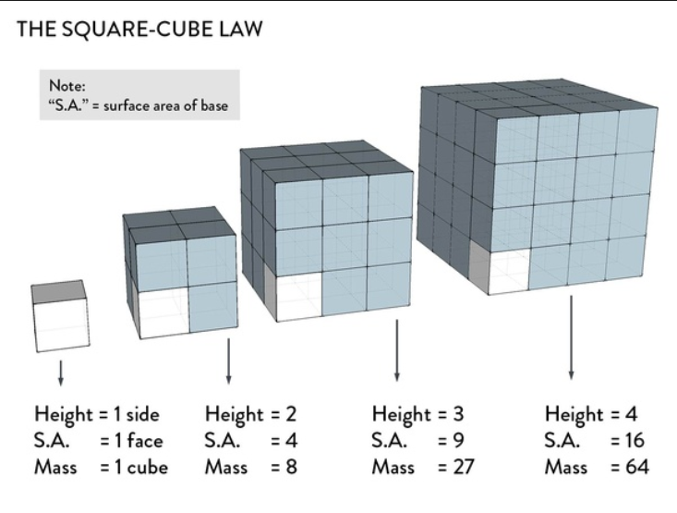
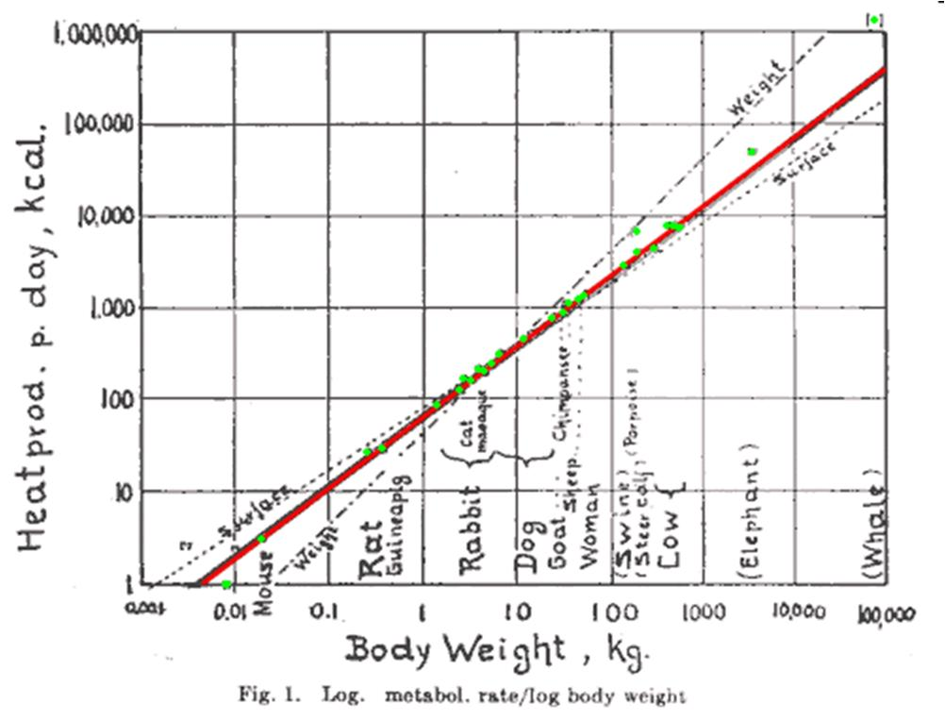
Allometric Scaling - Part 1

Slide 14
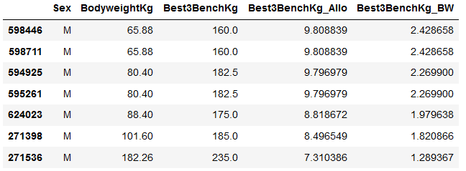
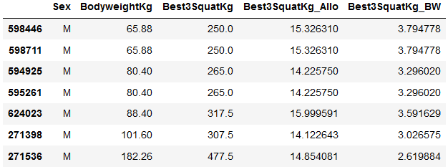
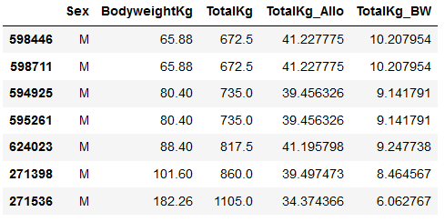
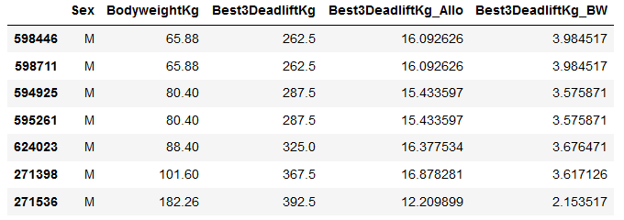
Allometric Scaling - Part 2

Slide 15
Future work
Statistical analysis
Pairwise t-tests on gender-equipment lift metrics
Lift comparisons irrespective of genders
Wilks
McCulloch
Glossbrenner
Explore other features
Lifting versus age
Progression of athletes through multiple meets

Slide 16
Questions?

